Slide 1
Repository Pattern (Part 1)
.NET Development

Slide 2
Data access in ASP.NET
In the course ASP.NET MVC you learned how to use a database in your webapplicition. What technology did we use?
We used Entity Framework to manage all database transactions. How does EF work? What class did we use? How was this class accessible in the controllers?
The DbContext was injected in the controller to gain access to the DbSets.
Entity Framework is an ORM. What does ORM stand for and why is it used?

Slide 3
Entity Framework
Database
MovieContext
Movies
Movie
Select … from Movie …
Application (Controller)
Rating
Ratings
Insert into Movie …
Update Movie Set …
Delete from Movie…
What if we decide to use other technology to access the DB?
Is it possible to test our controller methods?
We need to re-write all controllers in our application.

Slide 4
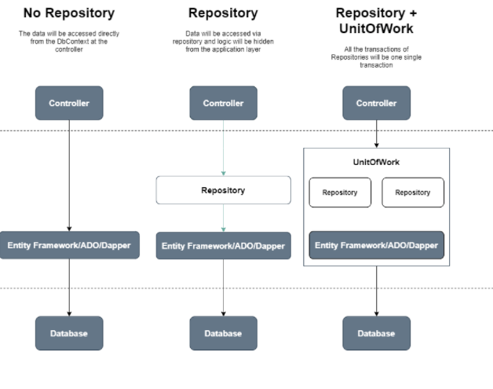
3 approaches for data access
In the course ASP.NET MVC, we used no repository.
In this chapter we create an extra layer called a Repository which encapsulates the Data Access Layer. Next chapter the Unit Of Work pattern is explained which let us work with transactions.

Slide 5
The way to go
Almost all pages in a webapplication interact with a database system. .Net developers use ORM tools like Entity Framework or Dapper to access these databases smoothly and efficiently.
BUT this is not enough to write state-of-the-art code. The concern is how to use these ORM tools to write code that is
reusable
maintainable
readable
and above all testable
This is were design patterns focus on. The repository and unit of work pattern try to solve common problems with database access and business logic transactions.

Slide 6
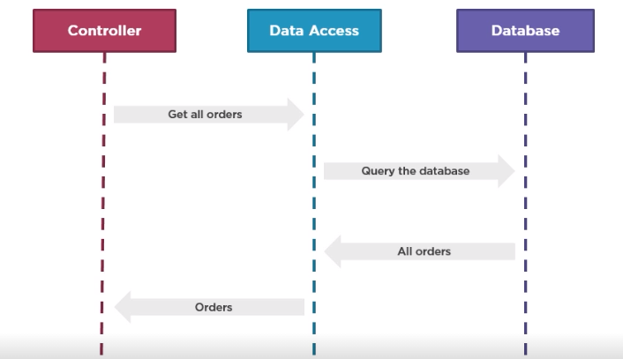
No repository
The controller (the application layer) is tightly coupled with the DAL (Data Access Layer) Testing the controller is more difficult while tests differ depending on the ORM used.
Hard to extend the model entities (cfr. shoppingcart).
Course ASP.NET MVC
Get all movies
Query the database
All movie records
Movie entities

Slide 7
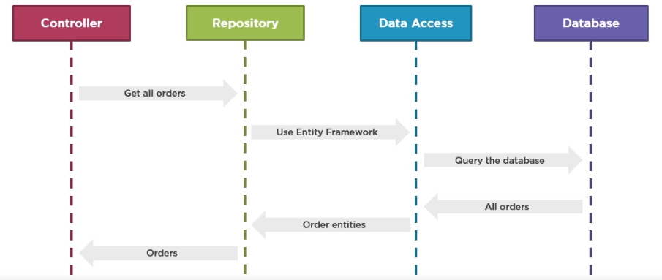
Applying the repository pattern
The controller is decoupled from the DAL. A repository class moves in between and decides on the ORM to use. Model entities can be changed before they reach the controller. Testing the controllers becomes more easily.
Get all movies
Movie entities
All movie records
Movie objects

Slide 8
What is a repository?
A repository encapsulates data access.
Repositories are just classes that implement data access logic and provide a data access service to the application layer.
The application layer as a consumer of the repository doesn’t need to know whether or not ADO.NET, EF or other ORMs like Dapper, … are used neither needs to care about the underlying data structure.

Slide 9
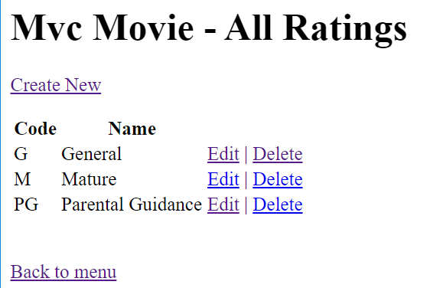
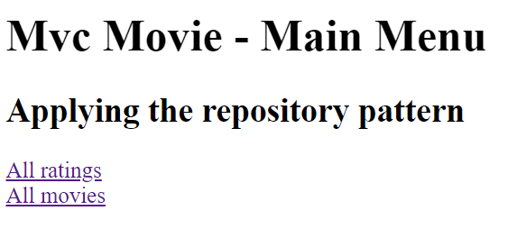
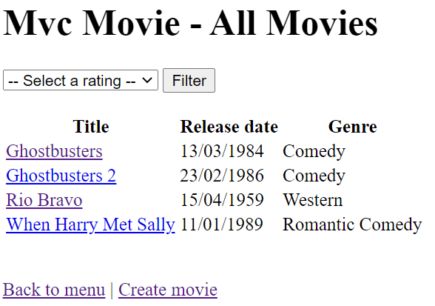
Demo
Open the solution MVCMovieDemo
Run the application.

Slide 10
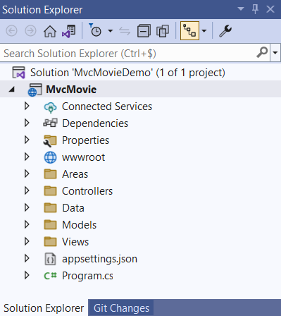
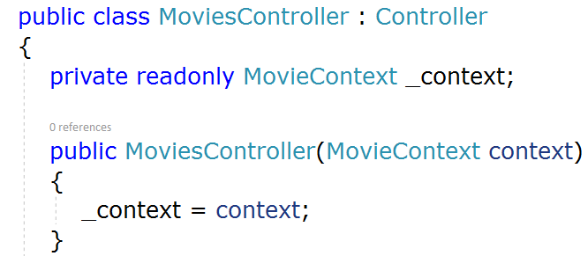
Demo
The project contains no repositories. How can we tell?
In the controllers the reference to EF is defined.
The controllers address the MovieContext directly.
How?

Slide 11

Repository Design Pattern
How many repositories do we need?
⇨ One repository for every model class. Not always, cfr. exercise Order/Orderline
What methods should we have in those repositories?
⇨ Each repository should contain at least the basic CRUD and query operations
Why it’s a good idea to define those methods at interface level?
⇨ Every repository needs to implement those methods. This way, you get consistency in the method definitions throughout your application.
Make a new folder ‘DAL’
Add new item | Interface ‘IRepository’

Slide 12
Create IRepository interface
Each repository must contain the following methods:
IEnumerable<T> GetAll()
T GetByID(int id)
void Insert(T obj)
void Delete(int id)
void Update(T obj)
void Save()
where T stands for the model entity.
How do we call an interface with such a T?
public interface IRepository<T>
{
IEnumerable<T> GetAll();
T GetByID(int id);
void Insert(T obj);
void Delete(int id);
void Update(T obj);
void Save();
}
Notes:
interface IRepository<T> {
IEnumerable<T> GetAll();
T GetByID(int id);
void Insert(T obj);
void Delete(int id);
void Update(T obj);
void Save();
}

Slide 13
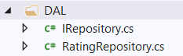
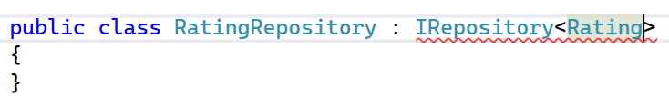
Create RatingRepository class in DAL
Add new item | Class ‘RatingRepository’
Implement the IRepository interface for a Rating entity (import the Models namespace)
What class do we need to implement all the methods?

Slide 14
RatingRepository class
First step is to make sure the Repository can access the database context (MovieContext).
This MovieContext is defined in a class variable (_context), and the constructor expects the calling object to pass in an instance of the context.
private MovieContext _context;
public RatingRepository(MovieContext context)
{
_context = context;
}
Notes:
private MovieContext _context;
public RatingRepository(MovieContext context)
{
_context = context;
}

Slide 15
RatingRepository class
The repository’s CRUD methods make calls to the database context in the same way that you saw earlier in the controller.
public IEnumerable<Rating> GetAll()
{
return _context.Ratings.ToList();
}
public Rating GetByID(int id)
{
return _context.Ratings.Find(id);
}
public void Insert(Rating obj)
{
_context.Ratings.Add(obj);
}
public void Delete(int id)
{
var rating = _context.Ratings.Find(id);
_context.Ratings.Remove(rating);
}
public void Update(Rating obj)
{
_context.Update(obj);
}
public void Save()
{
_context.SaveChanges();
}
Notes:
public class RatingRepository : IRepository<Rating>
{
private MovieContext _context;
public RatingRepository(MovieContext context)
{
_context = context;
}
public void Delete(int id)
{
var rating = _context.Ratings.Find(id);
_context.Ratings.Remove(rating);
}
public IEnumerable<Rating> GetAll()
{
return _context.Ratings.ToList();
}
public Rating GetByID(int id)
{
return _context.Ratings.Find(id);
}
public void Insert(Rating obj)
{
_context.Ratings.Add(obj);
}
public void Save()
{
_context.SaveChanges();
}
public void Update(Rating obj)
{
_context.Update(obj);
}
}

Slide 16
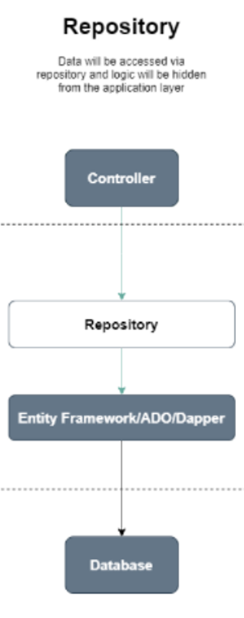
Change the RatingsController to use the repository
Since only the RatingRepository interacts with the database via EF, you must delete the EF-reference. Instead you add the DAL.
//using Microsoft.EntityFrameworkCore;
using MvcMovie.DAL;

Slide 17
Change the RatingsController to use the repository
Furthermore, the controller now declares a class variable for an object that implements the IRepository<Rating> interface instead of the MovieContext class. In the constructor the MovieContext is passed to the repository object.
In the CRUD methods, the repository need to be called instead of the context
private IRepository<Rating> ratingRepository;
public RatingsController(MovieContext context)
{
ratingRepository = new RatingRepository(context);
}
Notes:
TO DO: RatingController vrijgeven via Resources

Slide 18
Change the RatingsController to use the repository
public IActionResult List()
{
var ratings = _context.Ratings.OrderBy(r => r.Name);
return View(ratings.ToList());
}

Slide 19
Change the RatingsController to use the repository
public IActionResult Create([Bind("RatingID,Code,Name")] Rating rating)
{
if (ModelState.IsValid)
{
_context.Add(rating);
_context.SaveChanges();
return RedirectToAction("List");
}
return View(rating);
}

Slide 20
Change the RatingsController to use the repository
public IActionResult Edit(int id)
{
var rating = _context.Ratings.SingleOrDefault(r => r.RatingID == id);
return View(rating);
}

Slide 21
Change the RatingsController to use the repository
public IActionResult Edit(int id, [Bind("RatingID,Code,Name")] Rating rating)
{
if (ModelState.IsValid)
{
try
{
_context.Update(rating);
_context.SaveChanges();
}
catch (DbUpdateConcurrencyException)
{
throw;
}
return RedirectToAction("List");
}
return View(rating);
}

Slide 22
Change the RatingsController to use the repository
public IActionResult Delete(int id)
{
var rating = _context.Ratings.SingleOrDefault(r => r.RatingID == id);
_context.Ratings.Remove(rating!);
_context.SaveChanges();
return RedirectToAction("List");
}

Slide 23
Test AllRatings
All actions should work identically. The main difference is now that the controller calls the Repository for all data transactions.

Slide 24
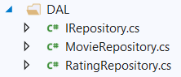
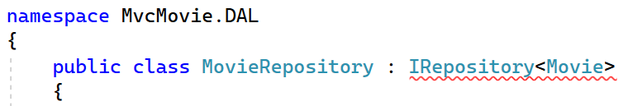
Create MovieRepository class in DAL
Add new item | Class ‘MovieRepository’
Implement the IRepository interface for a Movie entity
Make a copy of RatingRepository and make necessary changes.
Copy?? We must do better than that!!

Slide 25
MovieRepository class
First step is to make sure the Repository can access the database context (MovieContext). This DbContext is defined in a class variable (_context), and the constructor expects the calling object to pass in an instance of the context.
private MovieContext _context;
public MovieRepository(MovieContext context)
{
_context = context;
}
Notes:
private MovieContext _context;
public MovieRepository(MovieContext context)
{
_context = context;
}

Slide 26
MovieRepository class
Next step is to write the necessary CRUD transactions.
public void Delete(int id)
{
var movie = _context.Movies.Find(id);
_context.Movies.Remove(movie);
}
public void Update(Movie obj)
{
_context.Update(obj);
}
public void Save()
{
_context.SaveChanges();
}
public IEnumerable<Movie> GetAll()
{
return _context.Movies.ToList();
}
public Movie GetByID(int id)
{
return _context.Movies.Find(id);
}
public void Insert(Movie obj)
{
_context.Movies.Add(obj);
}

Slide 27
Change the MoviesController to use the repository
Since only the MovieRepository interacts with the database via EF, you must delete the EF-reference. Instead, you add the DAL.
//using Microsoft.EntityFrameworkCore;
using MvcMovie.DAL;

Slide 28
Change the MoviesController to use the repository
Furthermore, the controller now declares a class variable for an object that implements the IRepository<Movie> interface instead of the MovieContext class. In the constructor the MovieContext is passed to the repository object.
private IRepository<Movie> movieRepository;
public MoviesController(MovieContext context)
{
movieRepository = new MovieRepository(context);
}

Slide 29
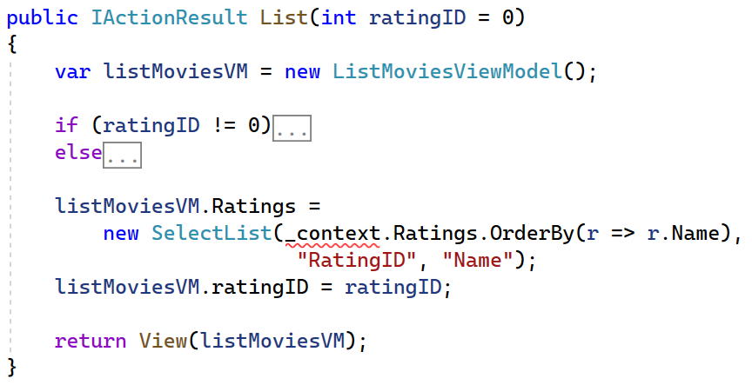
Change the MoviesController to use the repository
Is only instantiating the MovieRepository enough?
No, in the controller the RatingsRepository is needed!

Slide 30
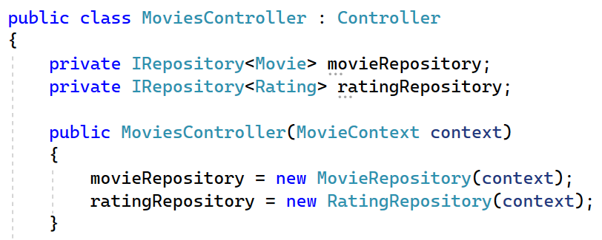
Change the MoviesController to use the repository
So the controller now declares 2 class variables. One for an object that implements the IRepository<Movie> interface and another one that implements the IRepository<Rating> interface. In the constructor the MovieContext is passed to each repository object.

Slide 31
Change the MoviesController to use the repository
Exercise: Next step is to call the CRUD methods in the repositories instead of the database context.

Slide 32
Change the List method in the MoviesController

Slide 33
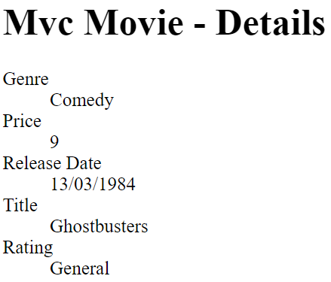
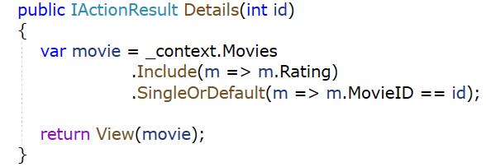
Change the Details method in the MoviesController
Notice that on the detailspage of a movie the entire rating name appears due to the EF Eager Loading principle.

Slide 34
Change the Details method in the MoviesController
Now this EF Eager Loading must be accomplished in the repository.
In the MovieRepository
public Movie GetByID(int id)
{
return _context.Movies
.Include(m => m.Rating)
.SingleOrDefault(m => m.MovieID == id);
}
In the MovieController
public IActionResult Details(int id)
{
var movie = movieRepository.GetByID(id);
return View(movie);
}

Slide 35
Test AllMovies
All functions should work. The main difference is now that the MoviesController calls both the Repositories for all the data transactions.

Slide 36
Concept of a generic repository
Next week, We'll do even better than this!

